Slide 1
The E-Filing Procedure and Process

Slide 2
Points of Interest
Document Format
Form/Template Modifications
Pro Se’s and Unrepresented Interested Parties –Designation of Email vs. No Designation of Email
Form Retention
E Doc Submission
Types of Nomenclature
What happens if done wrong?
What should my email look like?
What should I be getting if done correctly?
Tips and Exceptions
Notes:
________________________________________________________________________________________________________________________________________________________________________________________________________________

Slide 3
Document Format
Formats accepted:
-Word 97-2002 document (.doc)
-Word 2003-present document (.docx)
*Please note no other document format is acceptable at this time (e.g., PDFs, RTF’s, WPD’s, etc) are not acceptable and must be converted by attorney to word docs before sending to JA/Judge
Notes:
________________________________________________________________________________________________________________________________________________________________________________________________________________

Slide 4
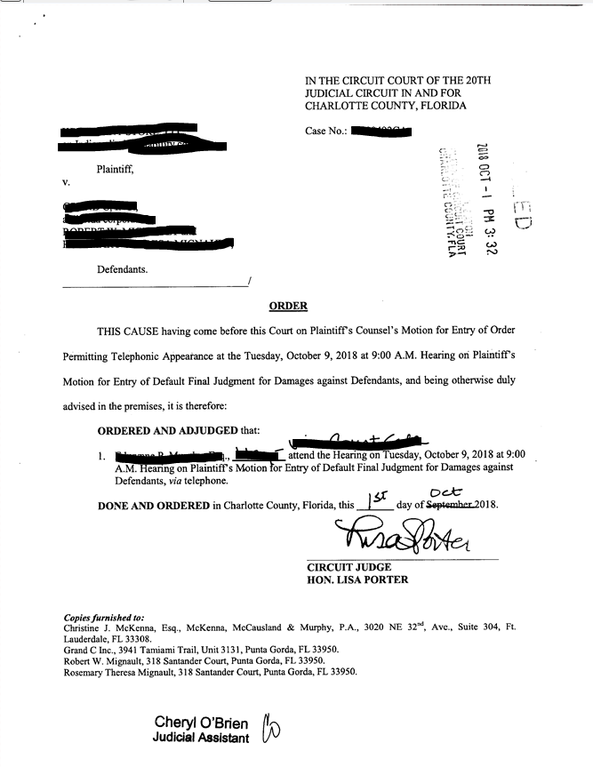
Form/Template Modifications
What it looked like before
Notice the done and ordered date
Notice the signature line
Note the cc: or service list area
Notes:
________________________________________________________________________________________________________________________________________________________________________________________________________________

Slide 5
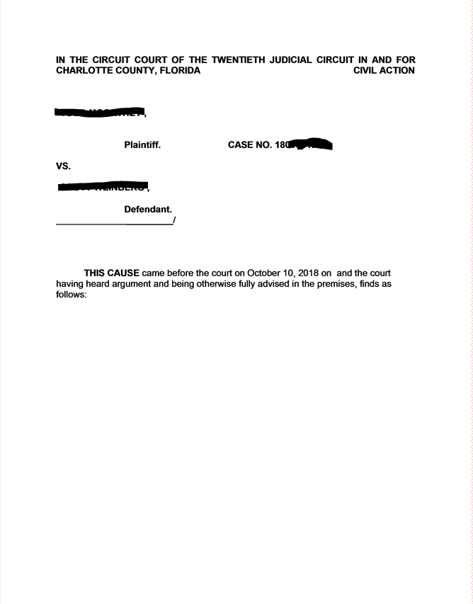
Form/Template Modification
What it should look like now:
No Done and Ordered paragraph
No signature line
No cc: or Service List Area
Notes:
________________________________________________________________________________________________________________________________________________________________________________________________________________

Slide 6
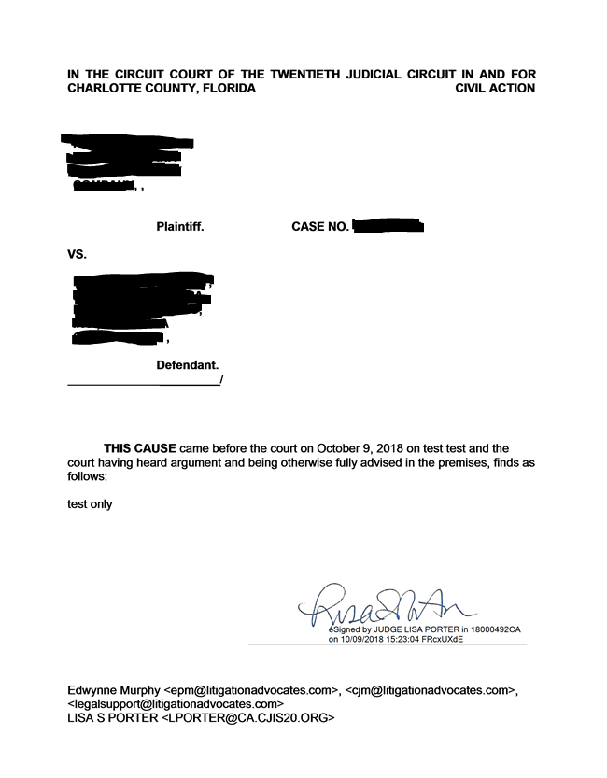
WHAT FORM WILL LOOK LIKE ONCE DONE
Notes:
________________________________________________________________________________________________________________________________________________________________________________________________________________

Slide 7
PRO SE’S AND UNREPRESENTED INTERESTED PARTIES
Designation of Emails
Court strongly recommends that you encourage all parties who must be served to provide their email for the portal to serve them.
Not mandatory for any party
www.flcourts.org for instructions on how to register their email
Notes:
________________________________________________________________________________________________________________________________________________________________________________________________________________

Slide 8
PRO SE’S AND UNREPRESENTED INTERESTED PARTIES
Non-Designation of Emails
No email designation? Court will print copies and mail.
Attorneys who submit the proposed order must furnish stamped envelopes.
Reference line should include “Envelopes Submitted” (Ex: 17456CP Estate of John Doe (Envelopes Submitted)
JA will manually add the party to the service list on the proposed order.
Notes:
________________________________________________________________________________________________________________________________________________________________________________________________________________

Slide 9
Form Retention
Save your forms locally and keep previous format
In the event that there are any computer issues, the previous format will be used
Notes:
________________________________________________________________________________________________________________________________________________________________________________________________________________

Slide 10
E-Doc Submission
Cha-circuitcivil@ca.cjis20.org
Each order sent as separate attachment
One email per case
Be sure that document is Word format, and stripped.
No more than (4) orders per email
Notes:
________________________________________________________________________________________________________________________________________________________________________________________________________________

Slide 11
What happens if done wrong?
EMAILS sent to wrong address
Order may be delayed
Order may be missed completely
Notes:
________________________________________________________________________________________________________________________________________________________________________________________________________________

Slide 12
What happens if done wrong?
Document not “modified” (i.e. “stripped”)
Will be rejected
Wrong document format sent
Will be rejected
Notes:
________________________________________________________________________________________________________________________________________________________________________________________________________________

Slide 13
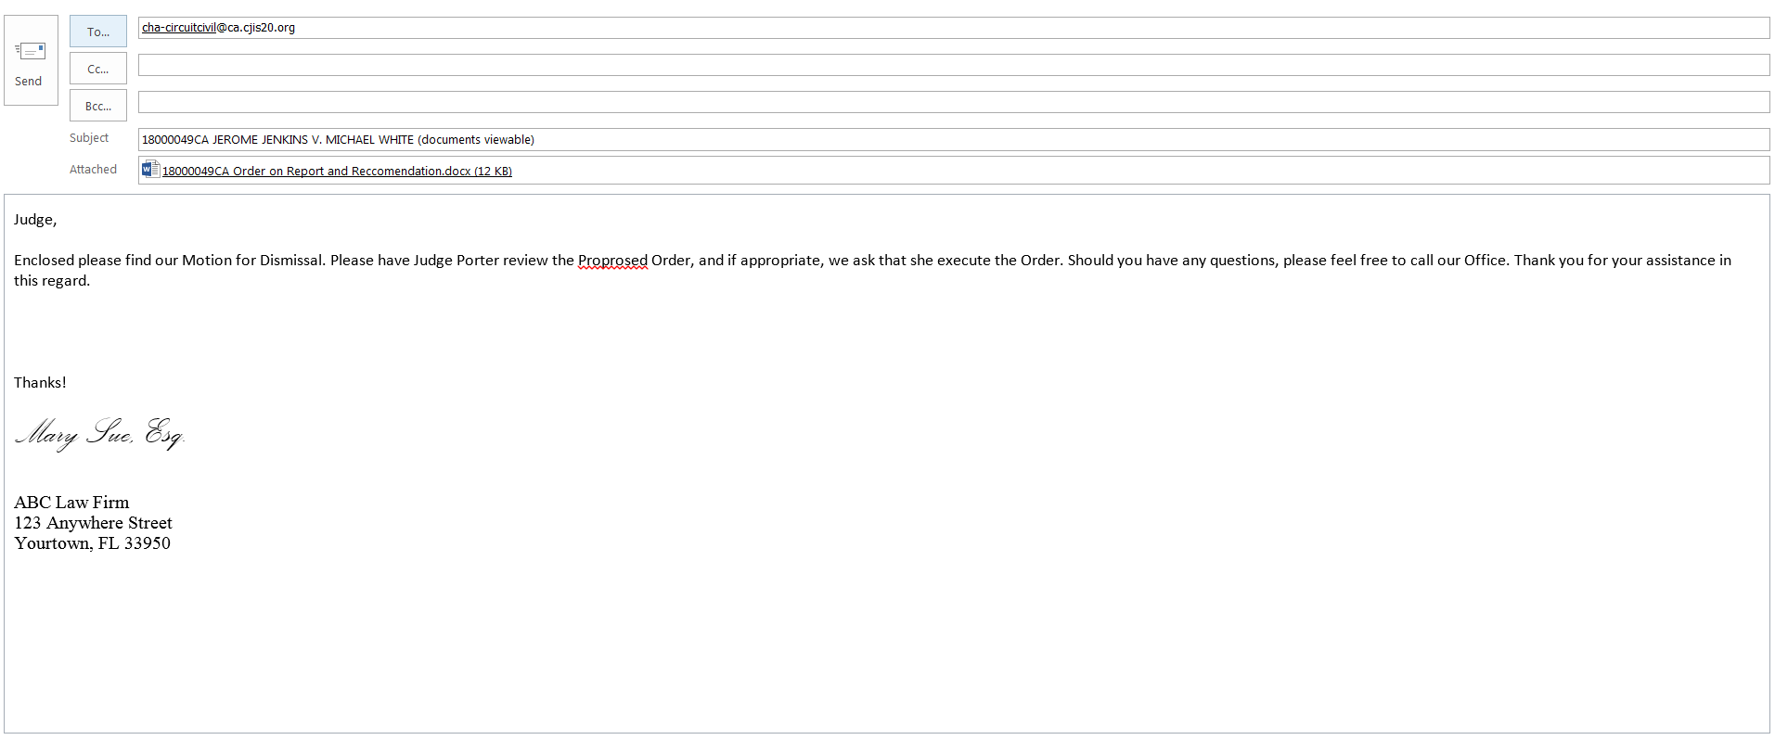
What should my email look like?
Notes:
________________________________________________________________________________________________________________________________________________________________________________________________________________

Slide 14
Tips and Exceptions
Body of Email now constitutes your cover letter
CC (carbon copy) opposing counsel on submission email
Notes:
________________________________________________________________________________________________________________________________________________________________________________________________________________

Slide 15
End
Questions?

