Slide 1

Twentieth Judicial Circuit of Florida
Administrative Office of the Courts
Interpreter and Translator
Services Department

Slide 2
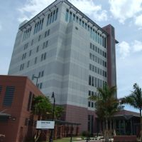
Our staff
Our Spanish interpreters are:
Elisa Avellana, Lee
Beverly Rimmer, Lee
Doresmi Torres Griffiths, Lee
Jorge Padro, Collier
Jorge Chavez Velarde, Collier
We also have a Creole interpreter
Maxime Joseph for both Lee and Collier
Our Support Staff
Irlena Fonseca, our Administrative Assistant
Nancy Rivera, our Court Program Specialist

Slide 3
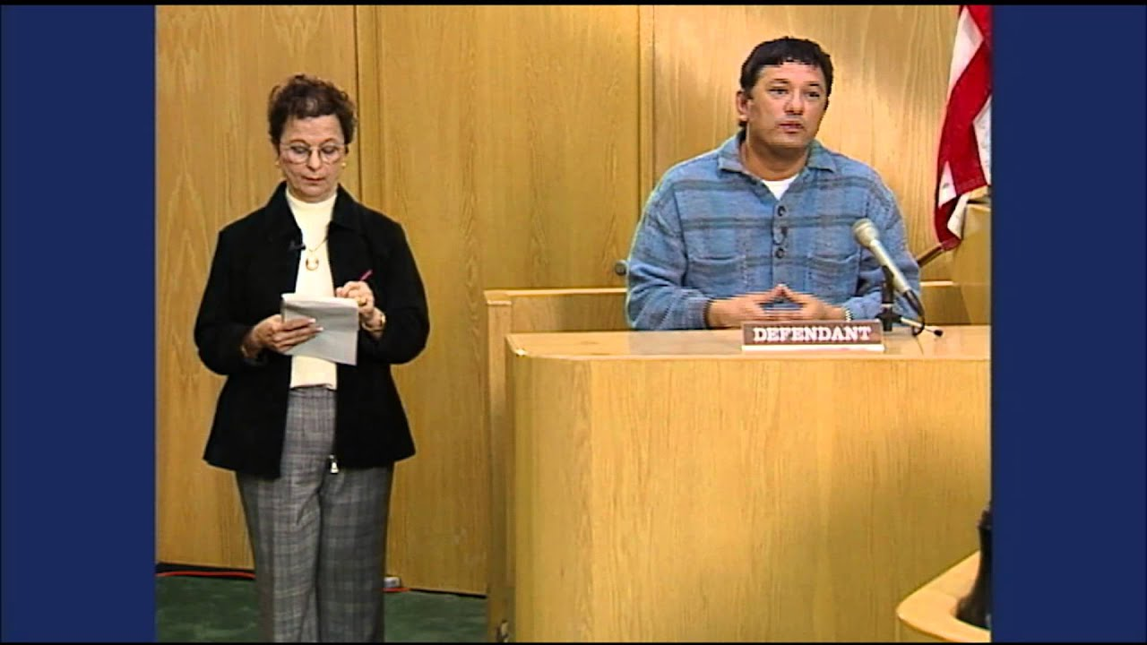
What we do
The role of the interpreter is to place the non-English speaker in the same footing as an English speaker in the legal setting.

Slide 4
The interpreter is ethically bound to:
Interpret fully and accurately
Transfer every element of meaning from source to target language
Not add or omit anything
Maintain the language level of the speaker
Not explain, simplify or summarize

Slide 5
Interpreters may face many obstacles that may hamper their accuracy and effectiveness.
If everybody understands the proper role of the interpreter, many obstacles can be overcome.

Slide 6
So the interpreter may hear:
The Judge may:
Instruct counsel or witness to speak audibly; to remember that turning their backs on the interpreter affects audibility; to remember interpreter has to hear over the sound of his/her own voice.
Instruct counsel to speak one at a time.
Ensure that the courtroom remains as quiet as possible.
Permit interpreter to sit where hearing is facilitated.
Instruct counsel/witnesses to moderate their rate of speech, especially when reading.

Slide 7
So the interpreter may prepare for proceedings:
The Judge may:
Instruct counsel to make available to interpreter, well in advance of proceeding, copies of affidavits, expert reports, pretrial motions, presentence reports, jury instructions, etc.
Instruct counsel to make available to interpreter a copy of any document distributed to opposing counsel during the course of proceedings; i.e. witness lists, reports or statements.

Slide 8
To ensure against interpreter error due to fatigue:
Grant periodic breaks if there is only one interpreter covering long hearings or trials. The rate of significant error in meaning increases at an increasing rate after 30 minutes of simultaneous interpretation.
Protect the interpreter’s recesses and lunch hours.

Slide 9
So the interpreter may prepare for proceedings:
Counsel may:
Give interpreter as much preparatory material as soon as possible.
Instruct witness on Interpreter protocol.
At a minimum, allow interpreter a short pre-proceedings interview with witness to become familiar with speech patterns/linguistic traits.
Ideally, conduct a pretrial interview with witness and interpreter, so attorney may discover potential cultural or linguistic stumbling blocks before they affect quality of testimony.

Slide 10
So the interpreter may prepare for proceedings:
Judge and Counsel may:
Be aware that cultural and linguistic differences may cause problems in communications and understanding.

Slide 11
THANK YOU FOR WATCHING
If you have any questions, please contact the Interpreter and Translator Services Department at (239) 533-1769.

