Slide 1
The E-Filing Procedure and Process for Dependency

Slide 2
Points of Interest
Document Format
Form/Template Modifications
Pro Se’s and Unrepresented Interested Parties –Designation of Email vs. No Designation of Email
Form Retention
E Doc Submission
What happens if done wrong?
What should my email look like?
What should I be getting if done correctly?
Tips and Exceptions
Notes:
________________________________________________________________________________________________________________________________________________________________________________________________________________

Slide 3
Document Format
Formats accepted:
-Word 97-2002 document (.doc)
-Word 2003-present document (.docx)
*Please note no other document format is acceptable at this time (e.g., PDFs, RTF’s, WPD’s, etc) are not acceptable and must be converted by attorney to word docs before sending to JA/Judge
Notes:
________________________________________________________________________________________________________________________________________________________________________________________________________________

Slide 4
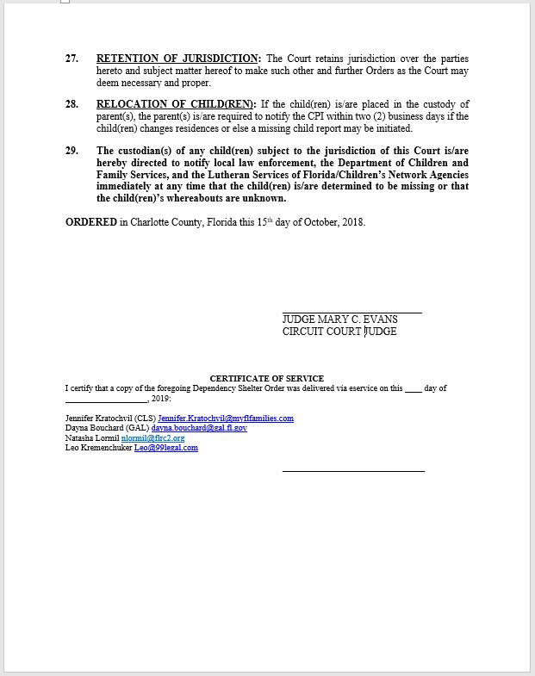
Form/Template Modifications
What it looked like before
Done and Ordered line is included
Judge Signature Line Included
Certificate of Service is included
Note Done
and
Ordered Line
Notice the signature line
Note the cc: or service list area
Notes:
________________________________________________________________________________________________________________________________________________________________________________________________________________

Slide 5
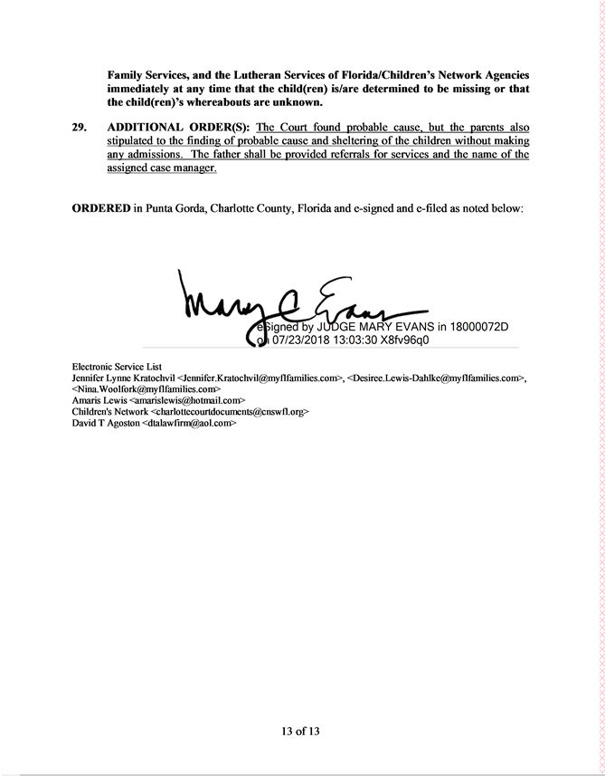
Form/Template Modification
What it should look like now:
Done and Ordered Line now changed
No signature line
Keep the CC: list area only
Report and Recommendations sent to Magistrate directly as .docx’s
Remove all areas that are not checked/appropriate
Notes:
________________________________________________________________________________________________________________________________________________________________________________________________________________

Slide 6
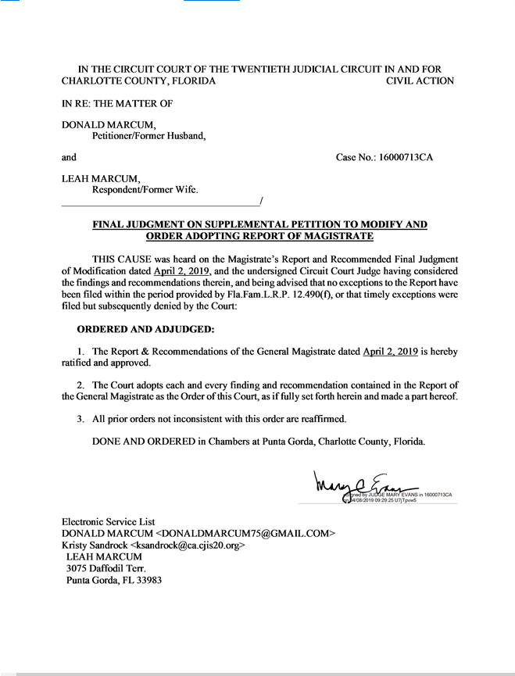
WHAT FORM WILL LOOK LIKE ONCE DONE
Notes:
________________________________________________________________________________________________________________________________________________________________________________________________________________

Slide 7
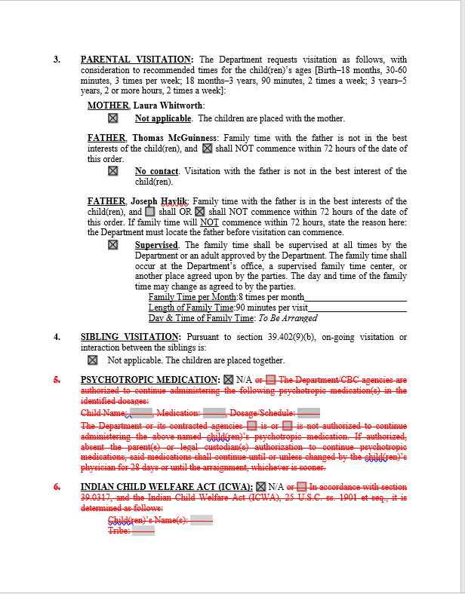
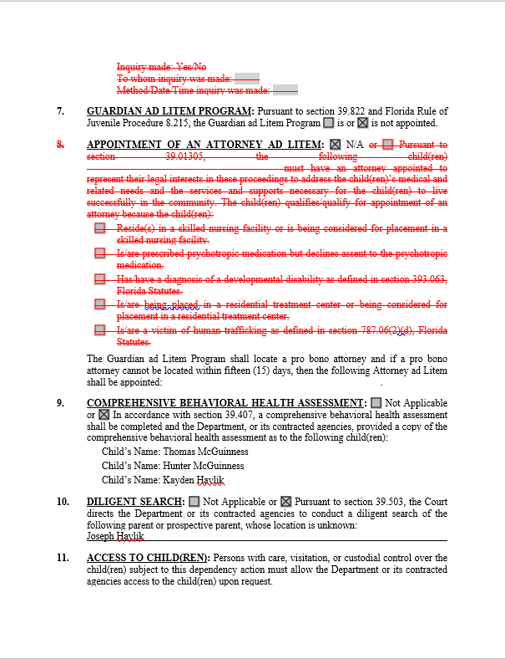
REMOVING EXTRAS/AREAS NOT RELEVANT (examples)
Notes:
________________________________________________________________________________________________________________________________________________________________________________________________________________

Slide 8
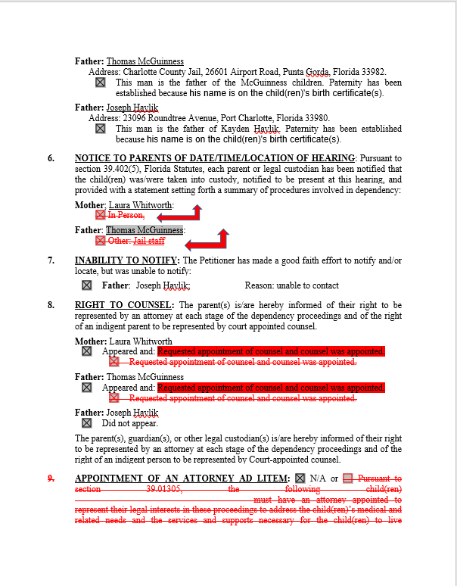
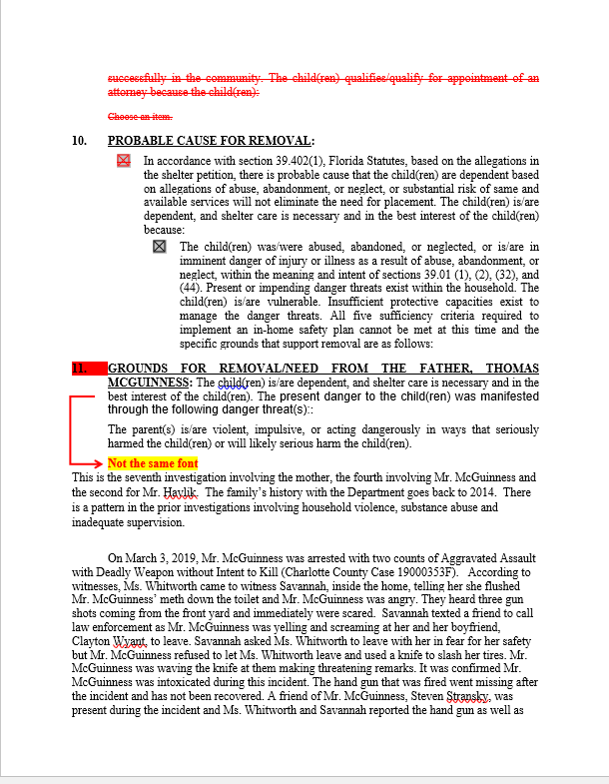
REMOVING EXTRAS/AREAS NOT RELEVANT (examples)
Notes:
________________________________________________________________________________________________________________________________________________________________________________________________________________

Slide 9
PRO SE’S AND UNREPRESENTED INTERESTED PARTIES
Designation of Emails
Court strongly recommends that you encourage all parties who must be served to provide their email for the portal to serve them.
Not mandatory for non-attorney parties/interested persons
www.flcourts.org for instructions on how to register their email
Notes:
________________________________________________________________________________________________________________________________________________________________________________________________________________

Slide 10
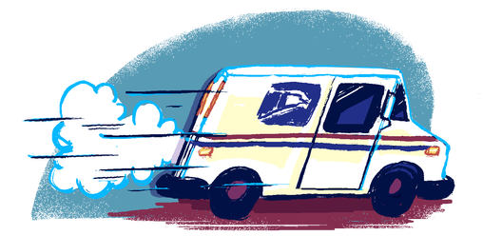
PRO SE’S AND UNREPRESENTED INTERESTED PARTIES
Non-Designation of Emails
No email designation? Court will print copies and mail.
Attorney must submit name and address of all parties who must be served by USPS in body of email
JA will manually add the party to the service list on the proposed order.
For further detail, please refer to Submission of Electronic Orders (see handout)
Notes:
________________________________________________________________________________________________________________________________________________________________________________________________________________

Slide 11
Form Retention
Save your forms locally and keep previous format
In the event that there are any computer issues, the previous format will be used
Notes:
________________________________________________________________________________________________________________________________________________________________________________________________________________

Slide 12
E-Doc Submission
cha-dependency@ca.cjis20.org (For Judge Evans)
Cha-magistrate@ca.cjis20.org (for Magistrate)
Each order sent as separate attachment
One order/report and recommendation per email
Notes:
________________________________________________________________________________________________________________________________________________________________________________________________________________

Slide 13
What happens if done wrong?
EMAILS sent to wrong address
Order may be delayed
Order may be missed completely
Notes:
________________________________________________________________________________________________________________________________________________________________________________________________________________

Slide 14
What happens if done wrong?
Document not “modified” (i.e. “stripped”)
Will be rejected
Wrong document format sent
Will be rejected
Document not edited for spacing
Will be rejected
Notes:
________________________________________________________________________________________________________________________________________________________________________________________________________________

Slide 15
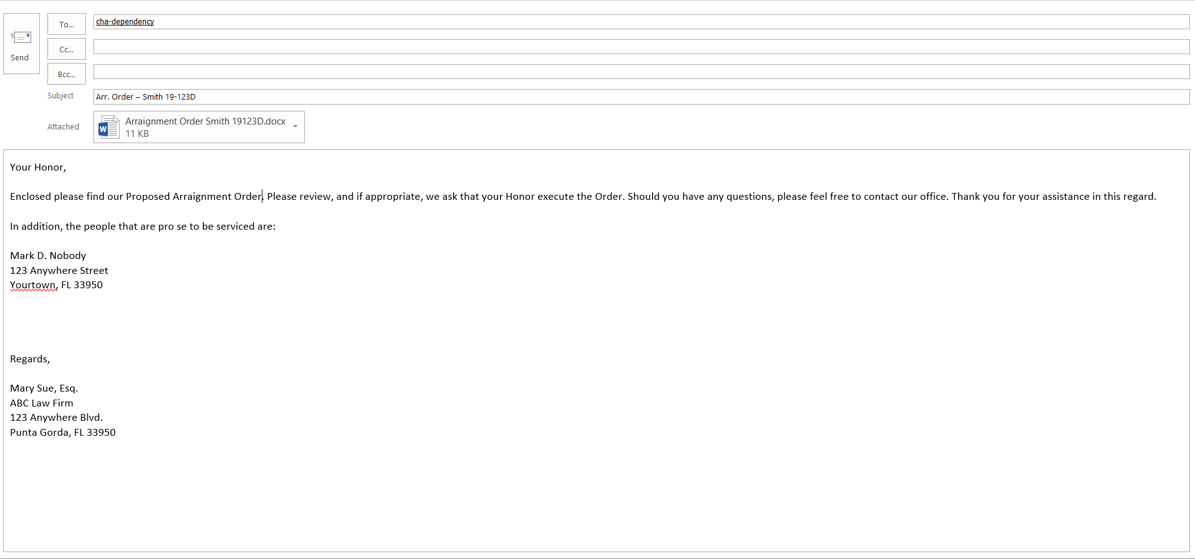
What should my email look like?
Notes:
________________________________________________________________________________________________________________________________________________________________________________________________________________

Slide 16
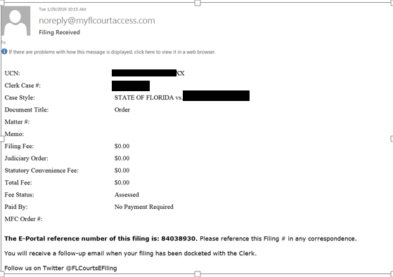
What you should be getting once order is processed
Notes:
________________________________________________________________________________________________________________________________________________________________________________________________________________

Slide 17
Tips and Exceptions
Body of Email now constitutes your cover letter
CC (carbon copy) opposing counsel on submission email
DO NOT include Judge/Magistrate on any “conversational” emails amongst parties
Keep CC:/List of Parties to be served on Proposed order
Do not email JA’s/Judge/Magistrate directly with orders, documents etc. These should all flow through the designated email.
Notes:
________________________________________________________________________________________________________________________________________________________________________________________________________________

Slide 18
End

